Slide 1

Sorting
Group Members:
Muhammad Faiz bin Anuar 198921
Mohd Taufiq bin Zaidong 195896
Muhammad Khairi bin Jamil 197654
Ammar Hakim bin Redzuwan 198394

Slide 2
Introduction
Sorting is the most common applications in computer science. The process through which data are arranged in either ascending or descending order according to their values.
Factors to consider in choosing sorting technique:
Number of item and load
Number of characters in item or record
Average case and best case
Average case and worst case
Sorter stabilization especially for sorter that use two keys

Slide 3
Categories Of Sorting
Internal Sorting:
If all the data that is to be sorted can be adjusted at a time in the main memory, the internal sorting method is being performed.
External Sorting:
When the data that is to be sorted cannot be accommodated in the memory at the same time and some has to be kept in auxiliary memory such as hard disk, floppy disk, magnetic tapes etc, then external sorting methods are performed.

Slide 4
Types of Sorting Used to Compare
Insertion Sort
A simple sorting algorithm that builds the final sorted array (or list) one item at a time. It is much less efficient on large lists than more advanced algorithms.
Comb Sort
An improvement from Bubble sort by using gap of size more than 1. The gap starts with a large value and shrinks by a factor of 1.3 in every iteration until it reaches the value 1. Thus Comb Sort removes more than one inversion counts with one swap and performs better than Bubble Sort.

Slide 5
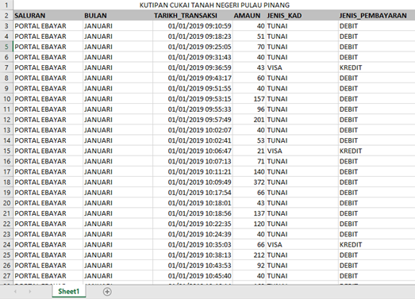
Data Used to Sort
For this data, the amount pay is the data that will be sort.
We used 100 of the data from amount pay column.

Slide 6
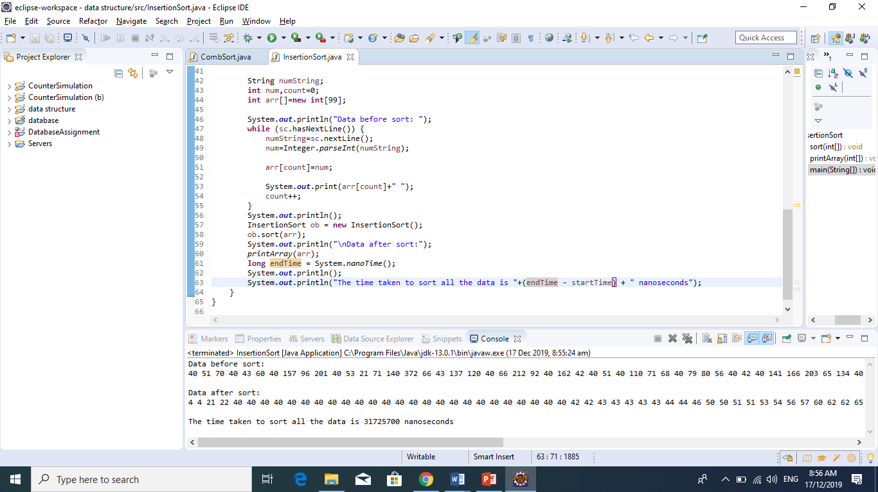
Output for Insertion Sort

Slide 7
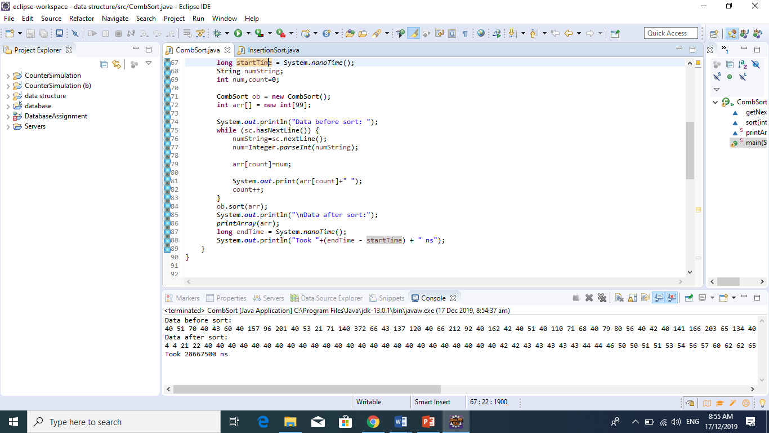
Output for Comb Sort

Slide 8
Comparison & Conclusion
The time taken for Insertion Sort is 31.7257 milliseconds while Comb Sort only takes 28.6675 milliseconds to finish sorting 100 of the data.
The comb sort is faster than the insertion sort because it sort in a specific gap until the gap become smaller removing the unnecessary need to check for each data.
The average running time for Comb Sort is O(n log n) while average running time for Insertion Sort is O(n^2)

